Slide 1
Welcome to the Causal Statistics for Treatment Models TD – S2

Slide 2
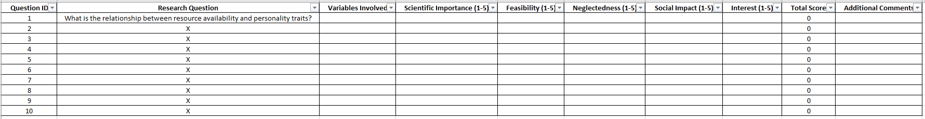
Step 1: Brainstorm 10 research questions using available variables

Slide 3
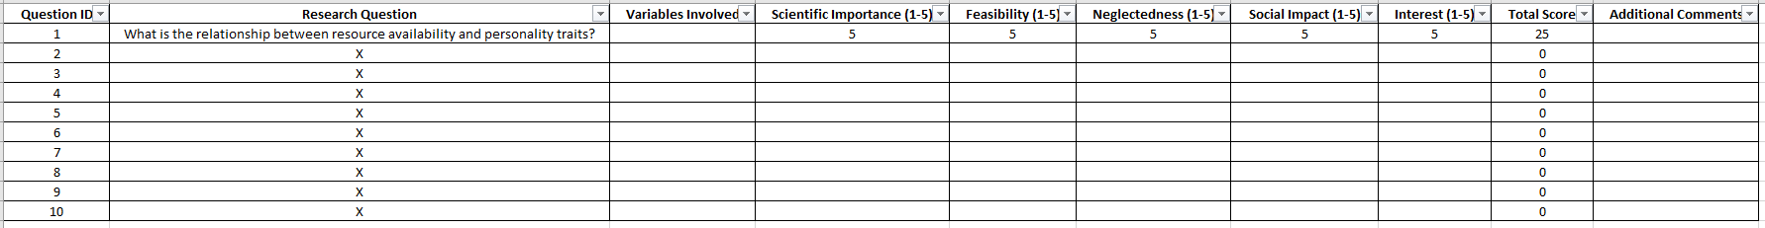
Step 2: Rate these questions and choose one of them

Slide 4
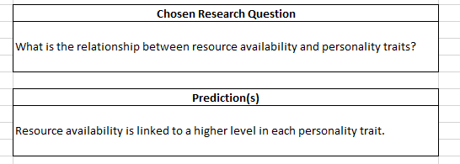
Step 3: Generate predictions regarding your chosen research question

Slide 5
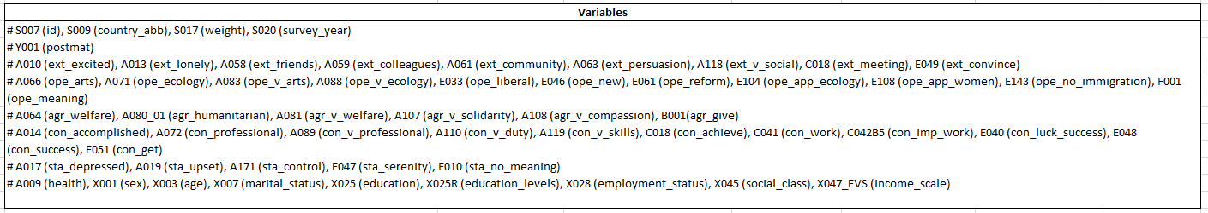
Step 4: Define which variables will be used

Slide 6
Step 5: Define which other confounding variables could impact your analysis

Slide 7
Step 6: Clean and prepare your data
(More on that soon)

Slide 8
Step 7 (optional): Validate your psychometric scales
(More on that soon)

Slide 9
Let me say a few words about psychometrics (this is particularly relevant for econometric analyses with psychological variables)

Slide 10
Step 7 (optional): Validate your psychometric scales
In my toy project, I will try to reconstruct personality data from the items of the European Values Study

Slide 11
What is personality?

Slide 12
At the origin of personality psychology
The lexical hypothesis (Galton, 1884)
Allport & Odbert (1936): extraction of 4504 adjectives from the dictionary
Cattell (1940): elimination of synonyms (-> 171 adjectives), several factor analyses allowed to find 16 traits
Moshoeu (2017)

Slide 13
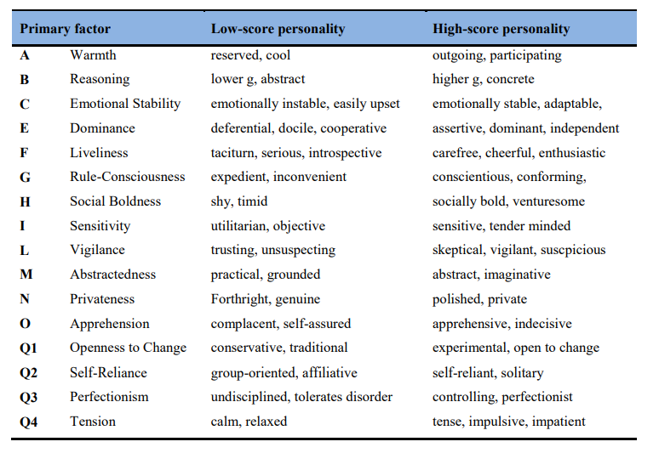
The sixteen personality factors questionnaire
Van Eeden et al. (2013)

Slide 14
From 16 to 5 factors
Several attempts didn’t manage to replicate Cattell’s factors
Fiske (1949), and Tupes & Christal (1961) found five factors, and thought it was an error of replication
Norman went back to the list of Cattell (1963), completed the original list of Allport and Odbert (1967), and found five factors each time!
Moshoeu (2017)

Slide 15
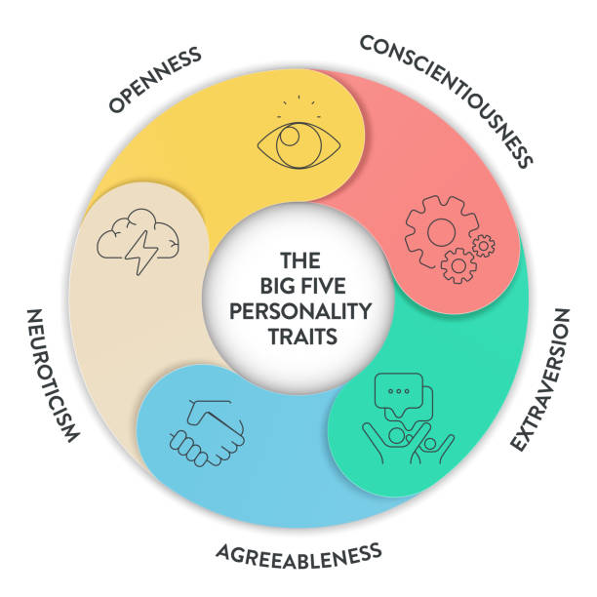
The Five Factor Model (Big Five)
Costa & McCrae (1992)

Slide 16
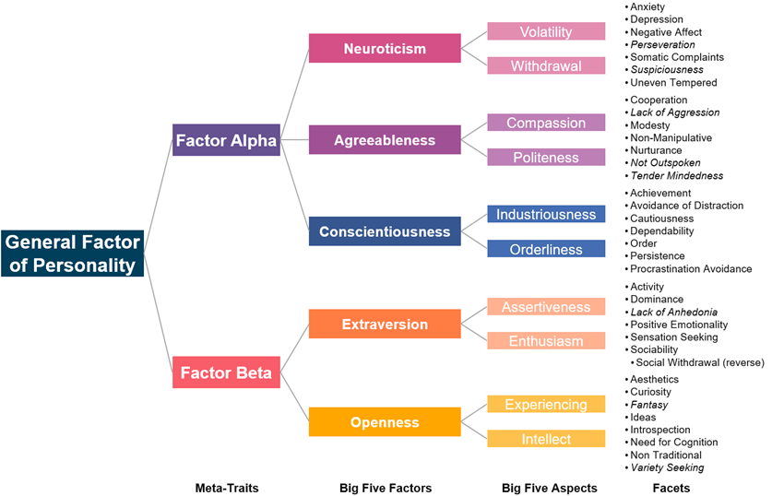
The structure of personality
Digman (1997), Musek (2007), DeYoung et al. (2007)

Slide 17
Is any psychological questionnaire valid?

Slide 18
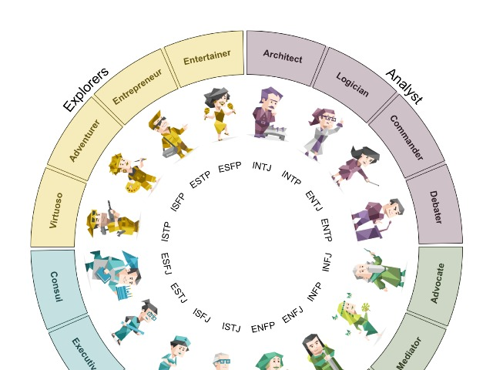

Slide 19
Why isn’t the MBTI used by researchers in psychology?

Slide 20
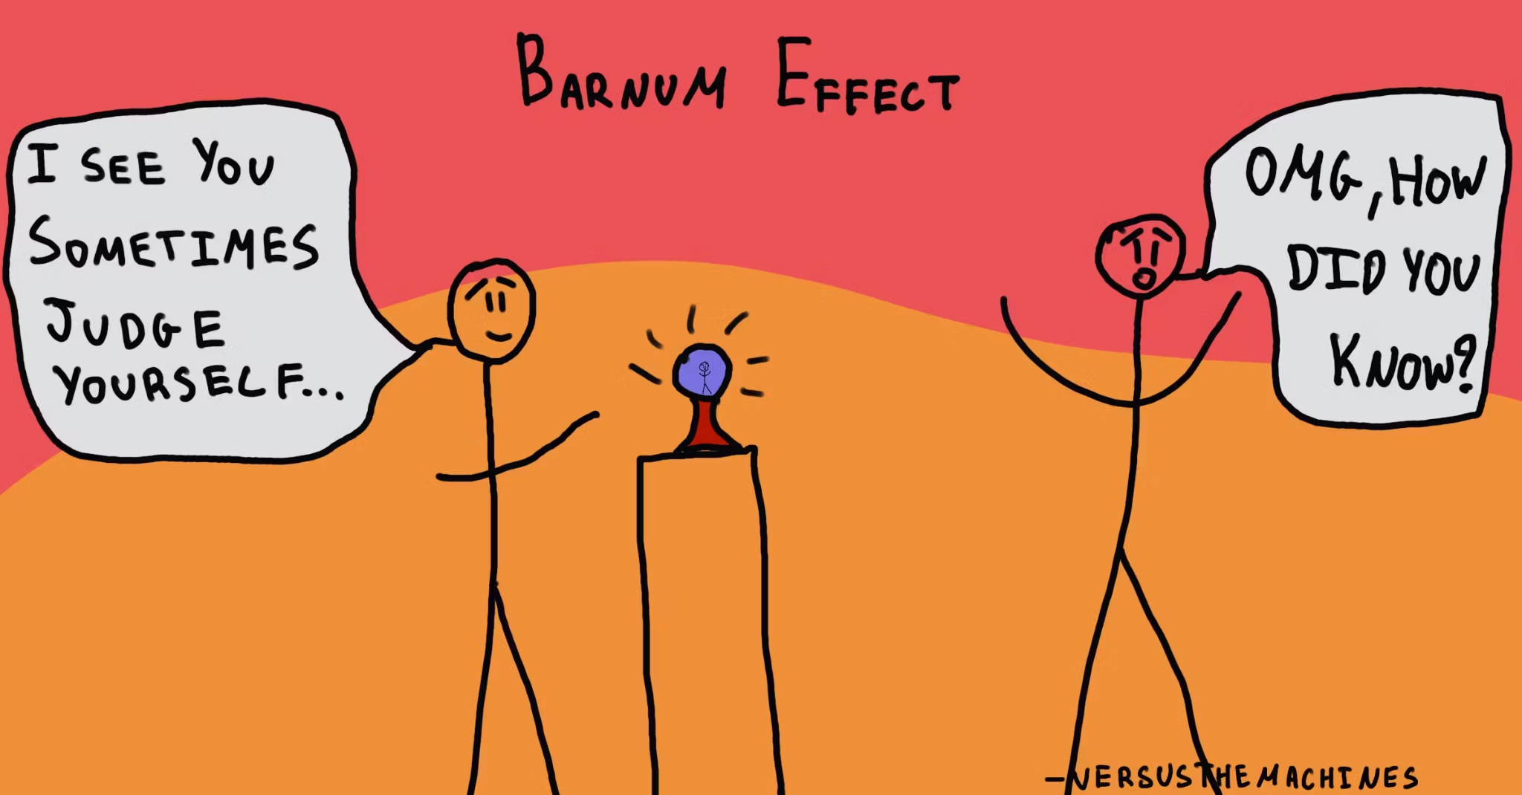

Slide 21
Psychometric criteria
Validity
Fidelity
Sensitivity and standardisation
Construct validity
Criterion validity
Internal consistency
Test-retest fidelity
Sensitivity
Standardisation
Am I measuring what I intend to?
Is my measure predictive?
Are items of my scale correlated with each other?
Are scores stable in time?
Are answers normally distributed?
Is each individual evaluated in the same way?
From the dictionary to a structure found in many cultures
Academic and professional success, well-being, etc.
Yes for each of the five dimensions
Stable over several years on average
Yes on representative samples
Standardised testing
Hansenne (2018)

Slide 22
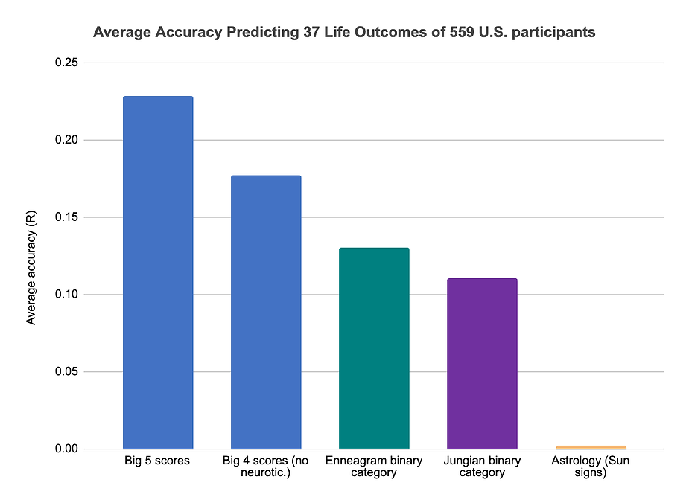
Notes:
https://www.clearerthinking.org/post/how-accurate-are-popular-personality-test-frameworks-at-predicting-life-outcomes-a-detailed-investi

Slide 23
If you collect psychological data, you can either use already valid psychometric questionnaire, or validate your own questionnaire

Slide 24
In our case, we will suppose that the variables of the European Values Study are valid

Slide 25
However, if you create indices regrouping several variables, it is relevant to evaluate the internal consistency (reliability) of your scale!

Slide 26
Let me show you the first steps of my own toy project!

Slide 27
Now, your turn!

Slide 28
Let’s wrap-up!
What did you manage to do during the session? Do you have questions or uncertainties?

